Slide 1

Electronics and Robotics Club, IIT Bombay
CODE THE PIXELS
An introduction to IMAGE PROCESSING
http://bit.ly/erc-ip

Slide 2
OVERVIEW
What are Images and What is Image Processing?
Reading images and videos in OpenCV
Thresholding
Colour/Object Detection using OpenCV
Blurring
Morphology
Edge Detection
Contours
Applications and Uses of Image Processing
Going “Deep"

Slide 3
Images as seen by Computers
The digital images are not continuous
They are divided into small blocks known as pixels(short for picture elements)
Each pixel has a intensity value
Range: 0 to 255
8-bit
More the pixels, more the variations and so better the quality
(Now you know why megapixel of camera matters)

Slide 4
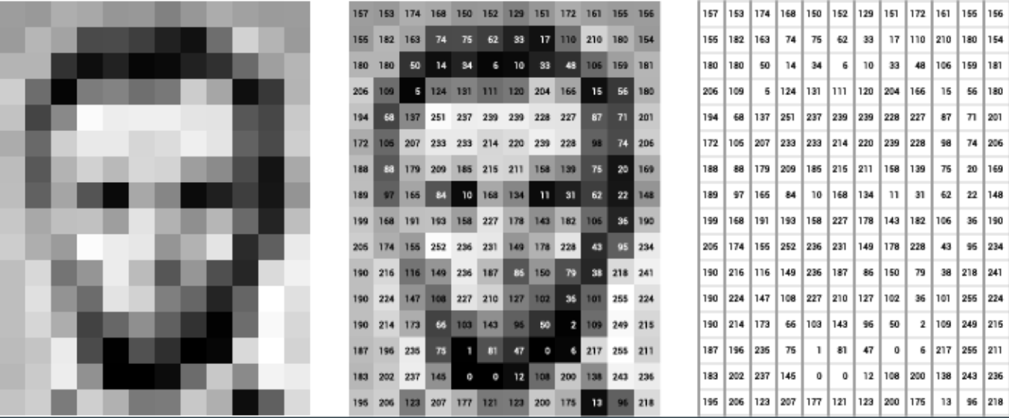
More the intensity, whiter the pixel
255 = pure white
0 = pure black

Slide 5
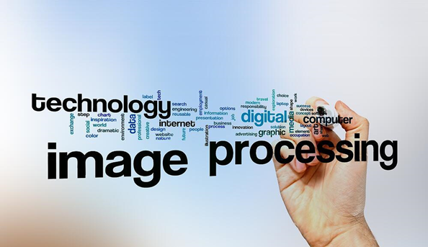

Slide 6
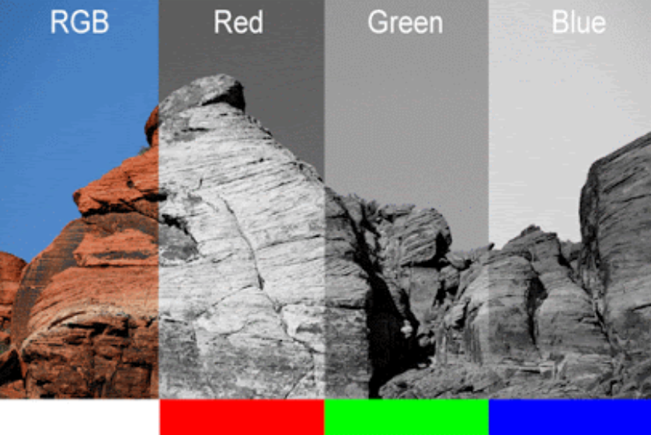
Colors!!!
Pixel no longer has 1 value
Multiple Channels to accommodate colors
Each channel is same as a grayscale image

Slide 7
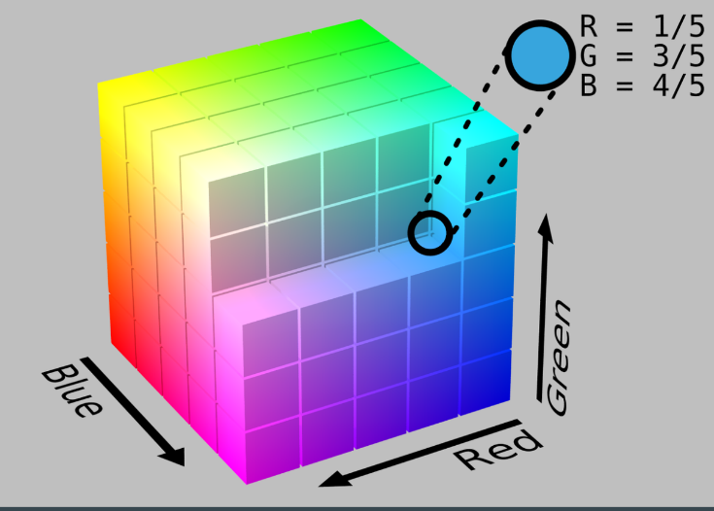
Color Formats
RGB format -
Red, Green, Blue format
OpenCV uses reverse format i.e. BGR.

Slide 8
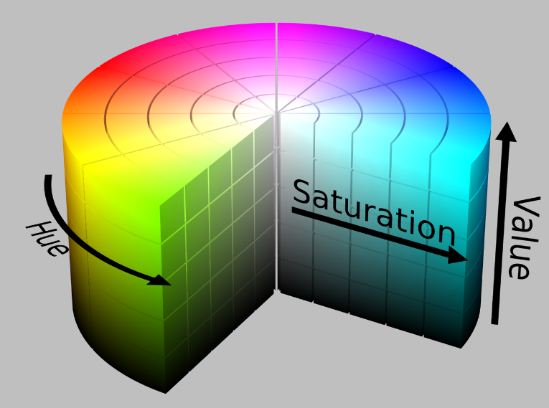
HSV format -
Hue, Saturation, Value format

Slide 9
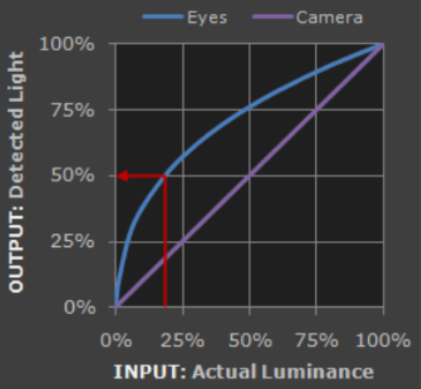
Gamma Correction
The human eye response is not linear with respect to intensity
It responds more to lower intensity level changes
Power Law:
Detected = (Luminance)^ɣ
Correction is done by taking the root

Slide 10
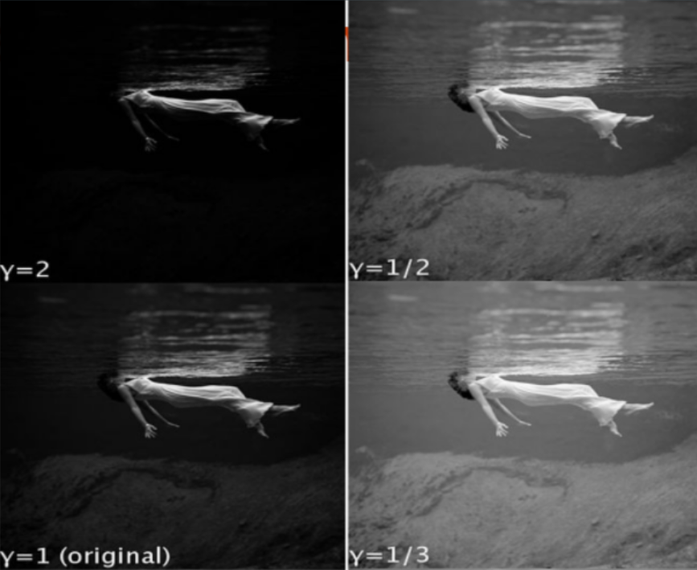

Slide 11
OpenCV Basics

Slide 12
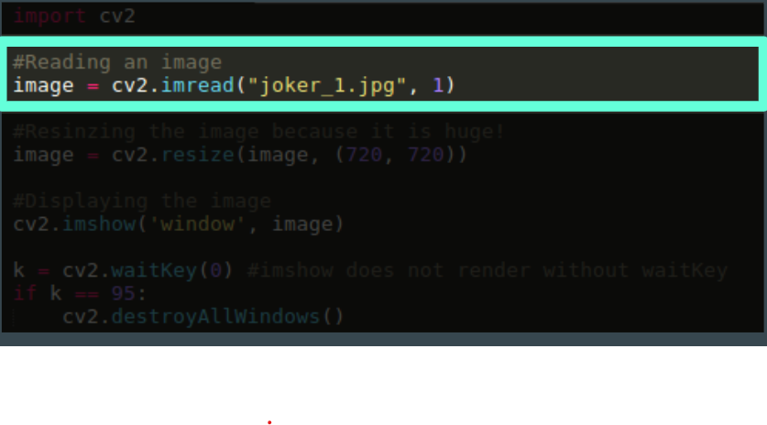
Reading an Image in OpenCV
cv2.imread(file_name, flag)
FLAG:
0 - Grayscale
1 - Coloured(BGR) image
-1 - Coloured image with alpha channels

Slide 13
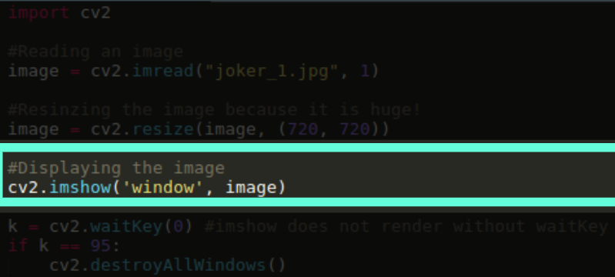
Showing an Image in OpenCV
cv2.imshow(Window_name, Image)
Window_name:
Name displayed on the display
Image:
The image to be showed

Slide 14
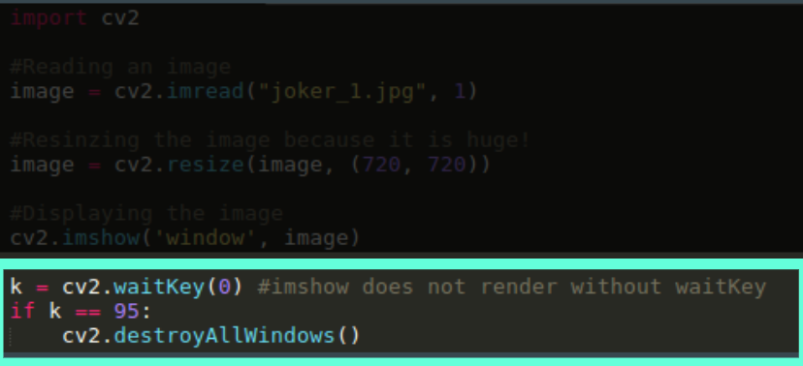
Showing an Image in OpenCV
cv2.waitKey(delay)
delay:
How much time(msec.) to wait before closing the window
0: don’t close automatically
returns:
Returns the ASCII value of the key pressed.

Slide 15
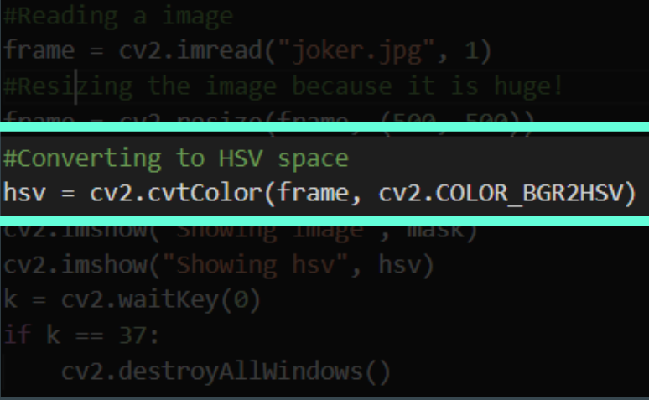
Changing between Color Spaces
cv2.cvtColor(src, code)
src:
Source image
code:
Code to specify the change in color space
General Format:
COLOR_<current>2<wanted>
https://docs.opencv.org/3.4/d8/d01/group__imgproc__color__conversions.html

Slide 16
Real Processing Starts Now!

Slide 17
Thresholding

Slide 18
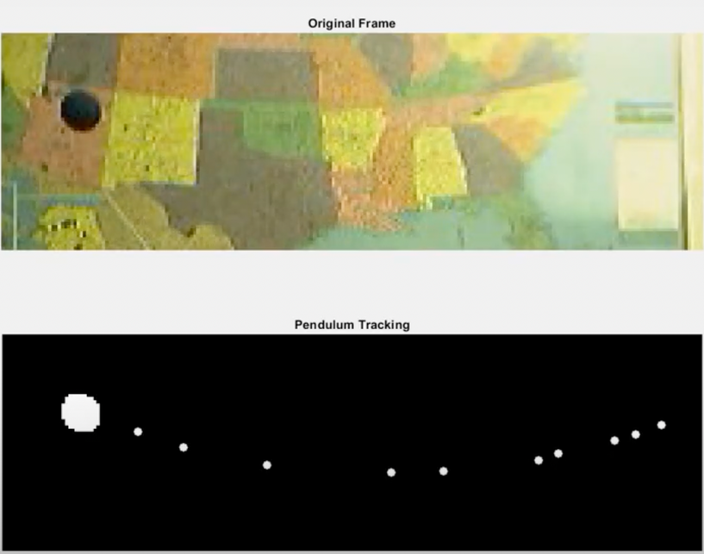
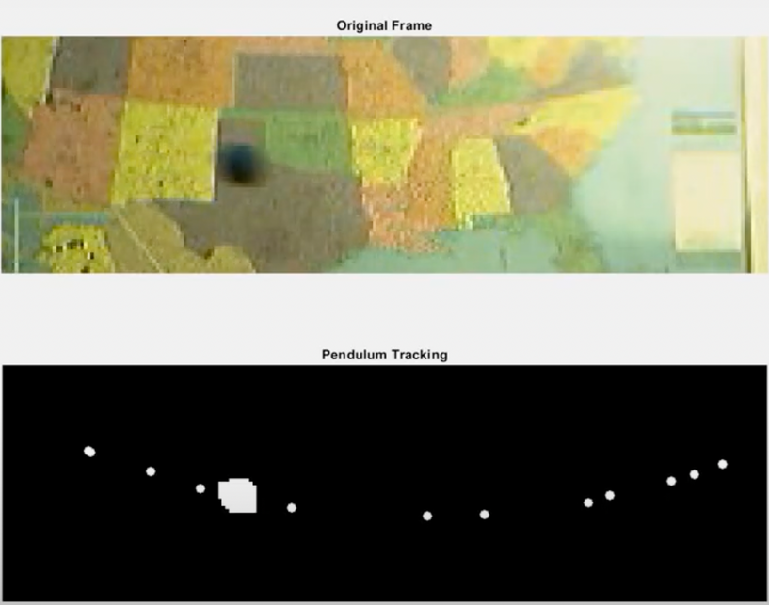
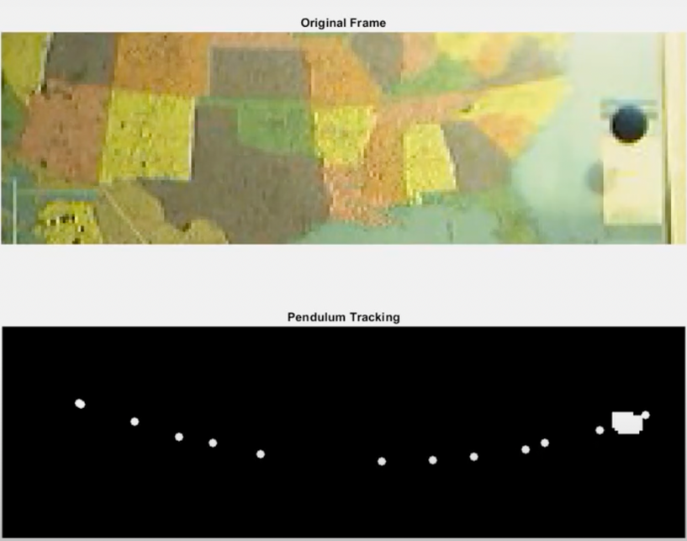
Pendulum Tracking using Thresholding

Slide 19
Simple Thresholding
Adaptive Thresholding

Slide 20
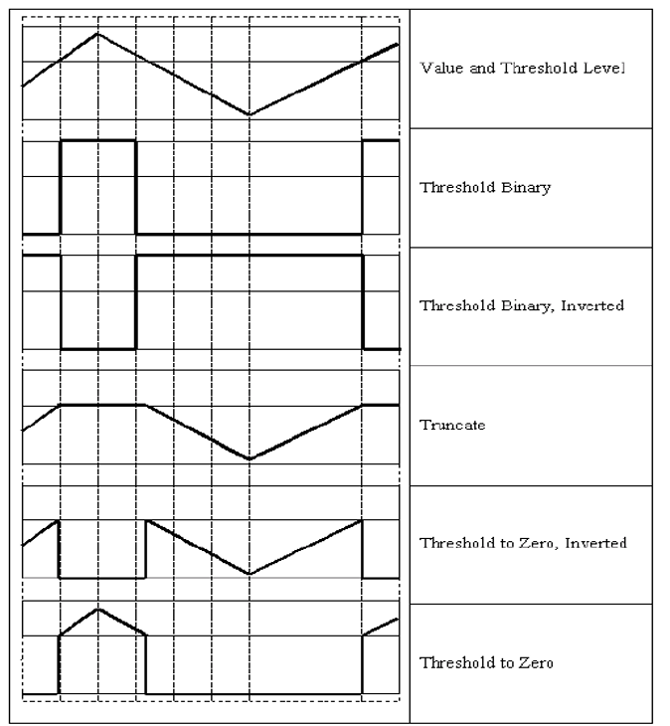
5 types of thresholding supported by openCV

Slide 21
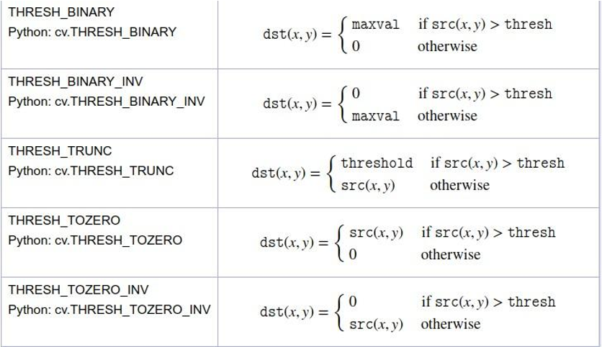
Simple Thresholding
Replace each pixel with some value depending on a given threshold.
Converts the grayscale image to binary image.

Slide 22
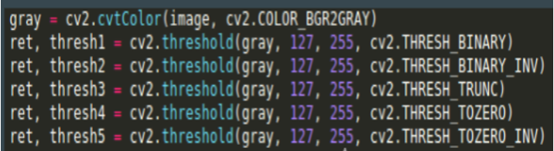
Simple Thresholding - OpenCV
cv2.threshold(src, thresh, maxval, type)
src:
The (grayscale) image to be thresholded
thresh:
The threshold to be used
maxval:
The maximum value to be used in THRESH_BINARY
type:
Type of thresholding to be used

Slide 23
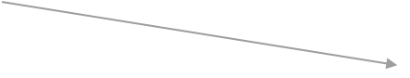
Adaptive Thresholding
Adaptive thresholding chooses a threshold for a pixel based on its neighboring pixels
There are two ways to calculate this threshold:
Using mean: Given a window size (let’s say 5 ✕ 5) we calculated the mean for all pixels in that window and then use that a threshold. Note that you will need to specify what type of thresholding you need(one of the 5 types discussed before)
Using weighted mean: This is similar as above only that weights are chosen from a normal distribution
Src maxValue adaptiveMethod thresholdType(only binary ones allowed) blockSize C

Slide 24
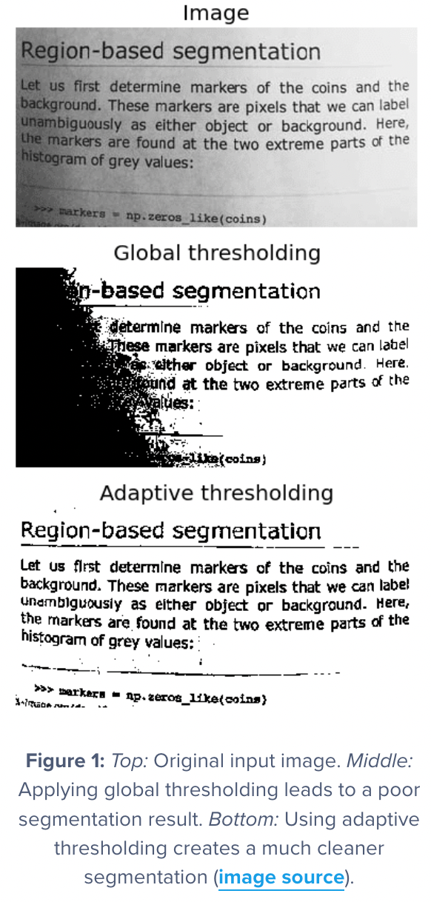

Slide 25
Color Detection

Slide 26
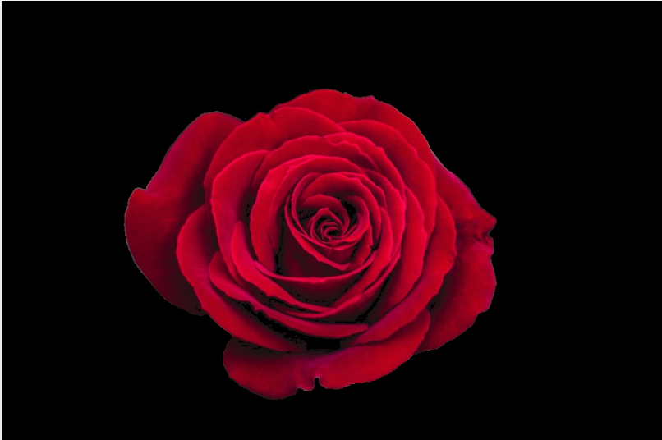
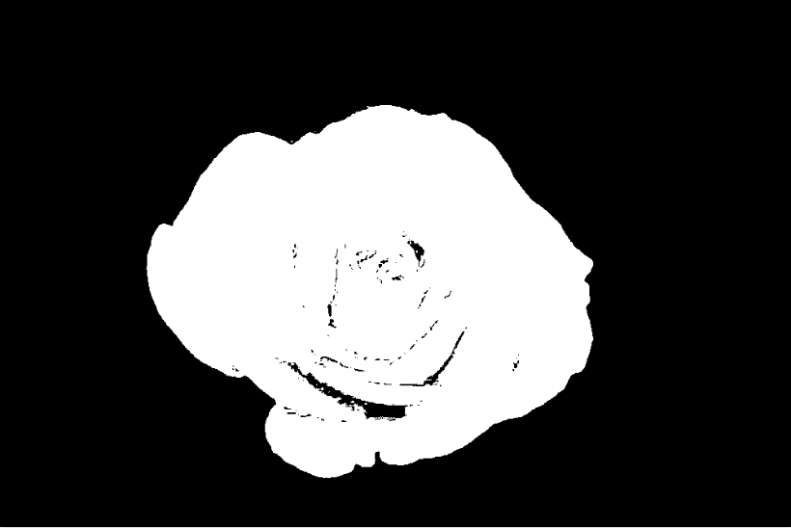
Masking

Slide 27
Masking
Mask allows us to focus on the portions of the image that interests us.
Use HSV format and apply filter on Hue channel
Good Range: [h-10, h+10]
Saturation and Value are generally kept for whole range. So, change according to need

Slide 28
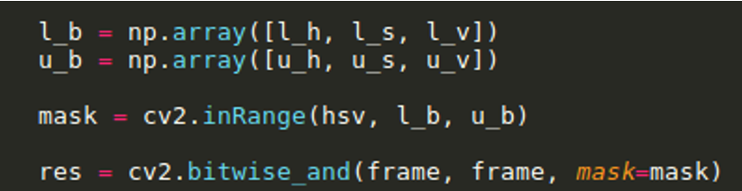
Color Detection
inRange(src, lowerb, upperb)
src:
The image to be thresholded
lowerb:
Lower bounds on the pixel intensity values
upperb:
Upper bounds on the pixel intensity values
RETURNS:
Binary mask
Note: In Opencv, Hue is between 0 and 180.

Slide 29
Blurring

Slide 30
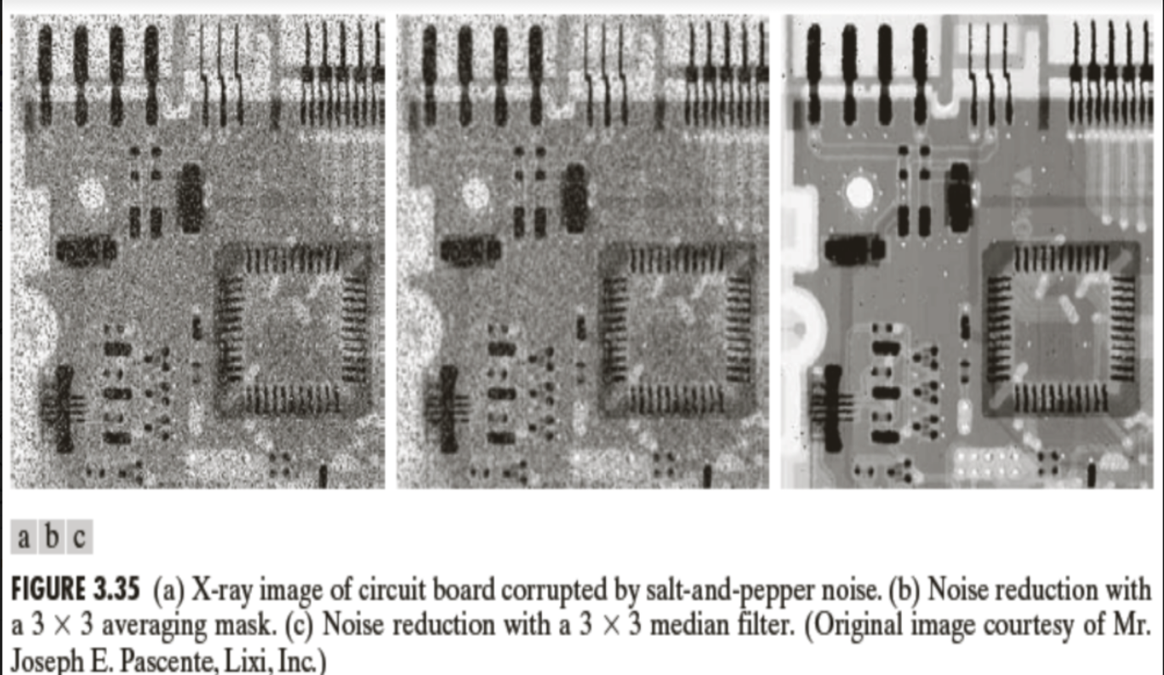

Slide 31
Averaging Blur(Box Filter)
Gaussian Blur(Gaussian Filter)
Median Blur(Median Filter)

Slide 32
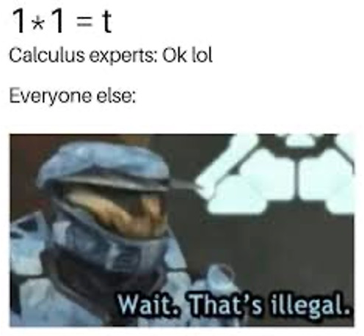
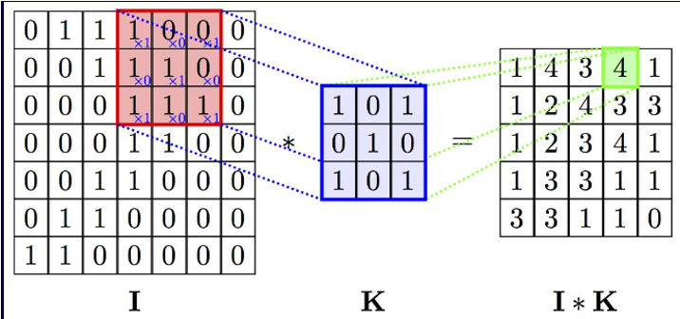
Kernel and Convolution
A kernel is nothing but a small matrix, also called convolution matrix.
Convolution can be thought of as weighted averaging around a pixel
Weights = kernel

Slide 33
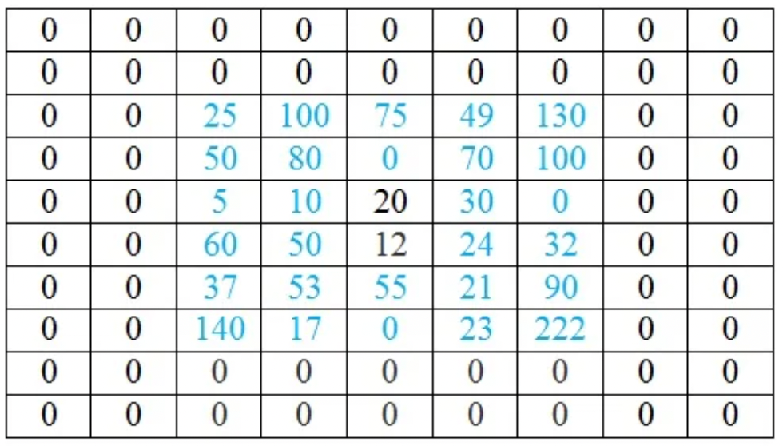
Kernel and Convolution - Padding

Slide 34
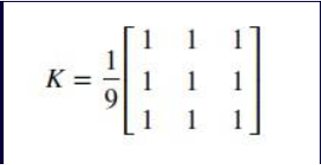
Averaging Blur(Box Filter)
The center of a n✕n kernel is replaced by the average of the n^2 pixels in it.
The kernel size is always an odd integer.
blur(image,size)
image: Image to be blurred
size: height and width of the kernel
RETURNS: blurred(convolved) image

Slide 35
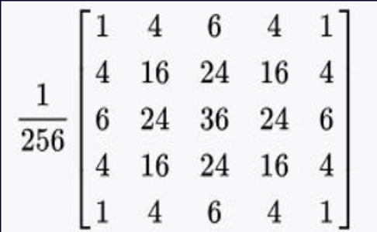
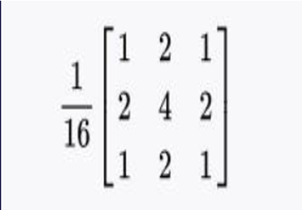
Gaussian Blur(Gaussian Filter)
The center of a n✕n kernel is replaced by the average of the n^2 pixels in it.
The kernel size is always an odd integer.
GaussianBlur(image,size,sigmaX,sigmaY=None,borderType=None)
image: Image to be blurred
size: height and width of the kernel
sigmaX: standard deviation of the kernel in X direction(if 0, calculated from size)

Slide 36
Median Blur(Median Filter)
The center of a n✕n kernel is replaced by the median of the n^2 pixels in it.
Highly useful in reducing noise from images.
In the above filters, a pixel is set to a calculated value that might not belong to any surrounding pixels. In this method, we set a pixel to value which is present in its neighbourhood. This reduces noise very effectively.
medianBlur(image,size)
image: Image to be blurred
size: size of the window in which median is to be taken
RETURNS: blurred(convolved) image

Slide 37
Noise Reduction using blur

Slide 38
Some other Processing

Slide 39
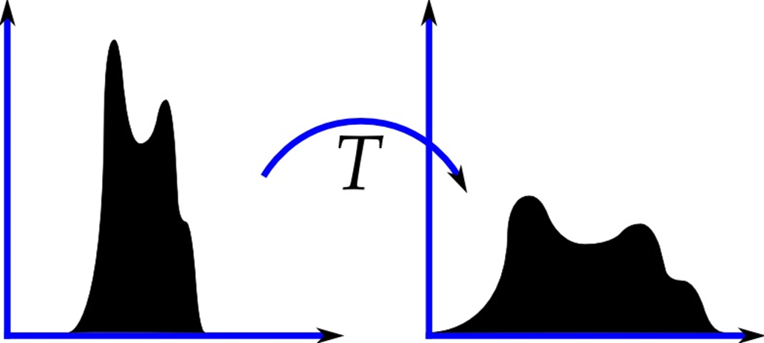
Histogram
Number of Pixels vs. Pixel Values
More variance implies better "contrast"

Slide 40
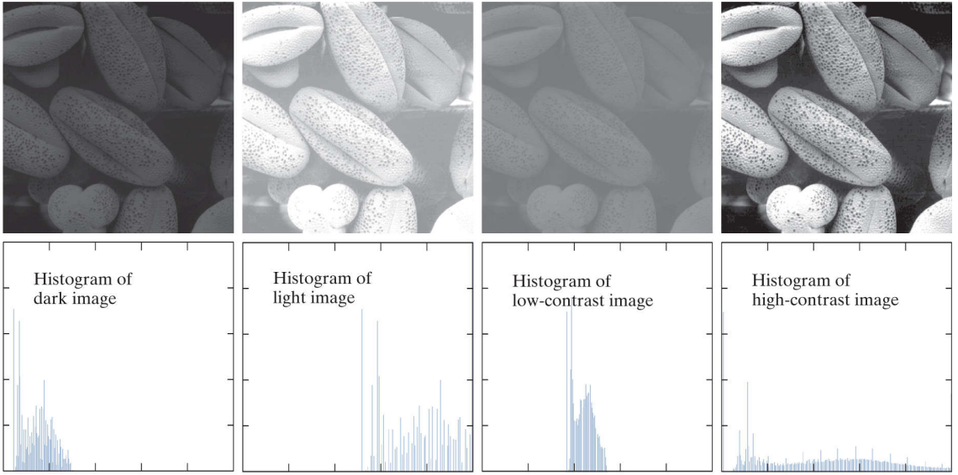
Histogram Equalization

Slide 41
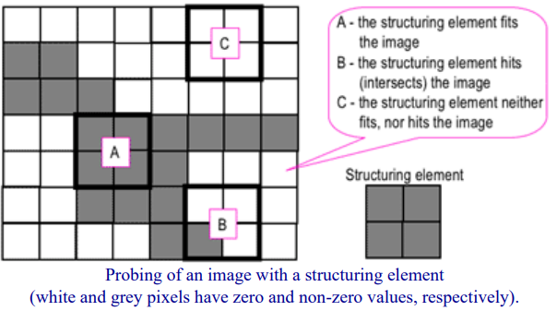
Morphology

Slide 42


Morphology
Erode -->
<-- Dilate

Slide 43
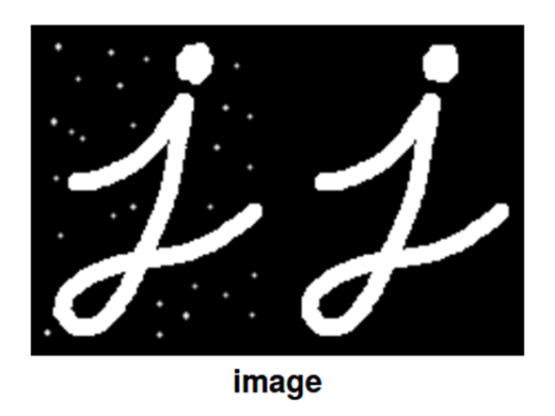
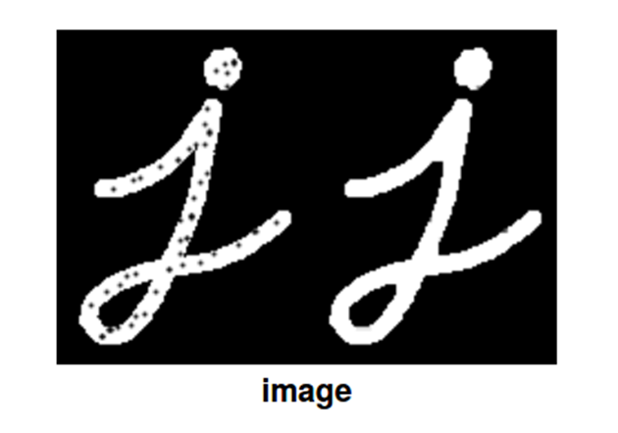
Morphology
Open - Erode and then Dilate
Essentially removes white dots
Close - Dilate and then Erode
Essentially fills up black dots

Slide 44


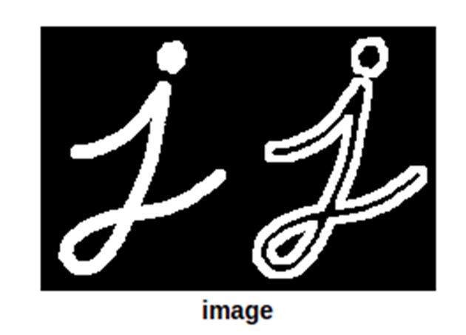
Morphology
Gradient - Difference in erosion and dilation

Slide 45
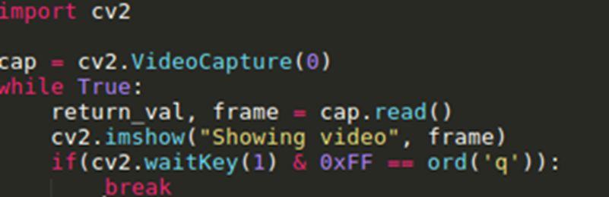
Capturing from webcam in OpenCV
0 - Open Default Camera
return_val is True/False depending on success/failure of reading the video

Slide 46
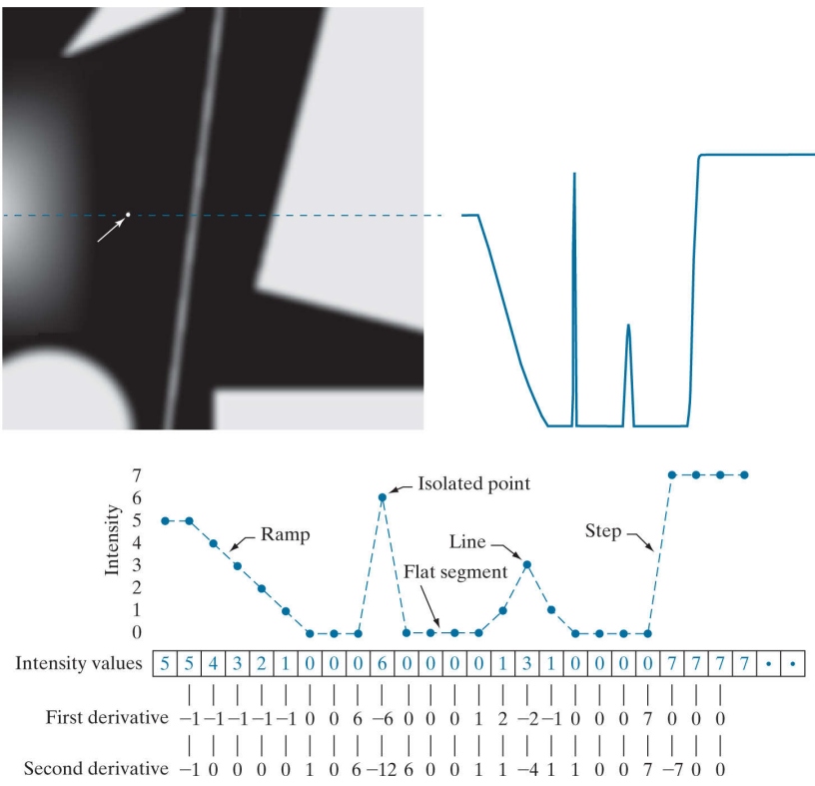
Image Segmentation
First Order Derivative
thicker edges
Second-Order Derivative
fine details - isolated points, line
double edge response at ramp and step
to determine transition from light to dark or dark to light

Slide 47
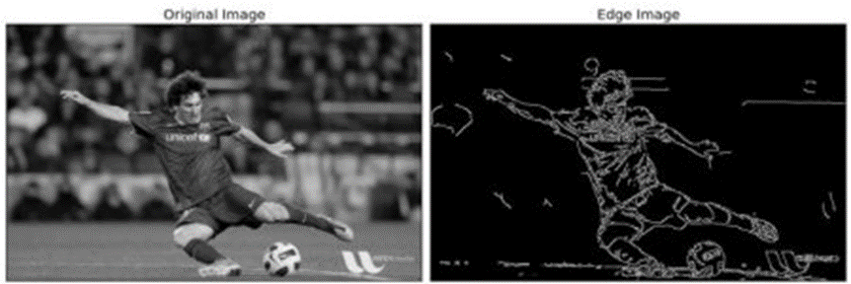
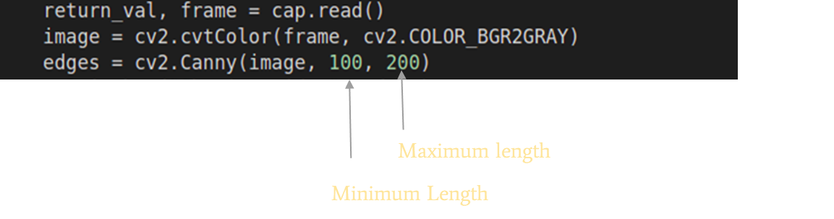
Edge Detection
Canny Edge Detection
Works on gray scale images

Slide 48
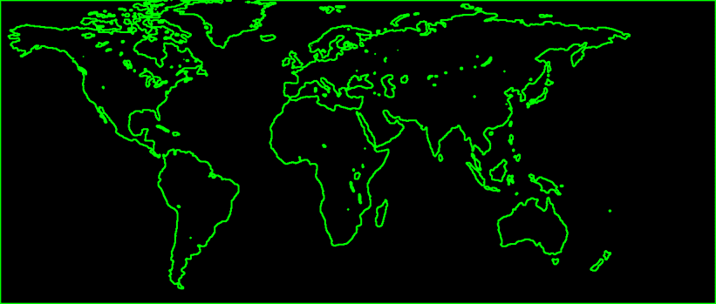
Contour Detection
A Contour is a closed curve joining all continuous points having same color or intensity. This is a important tool in shape analysis and object detection.

Slide 49
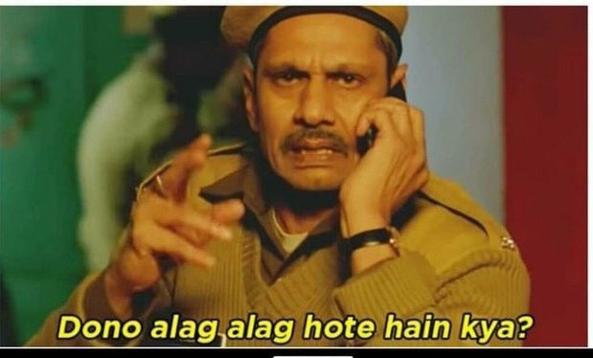
Difference ?
Edge Detection and Contour Detection

Slide 50
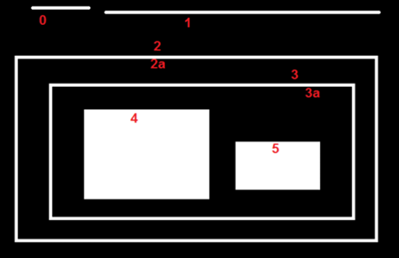
Contour Detection
Better accuracy is obtained when we use binary images. So before finding contours we can apply thresholding or canny edge detection.
findContours(img, mode, method)
img: The image to be thresholded
mode: retrieval method (hierarchy)
method: approximation method (corners)

Slide 51
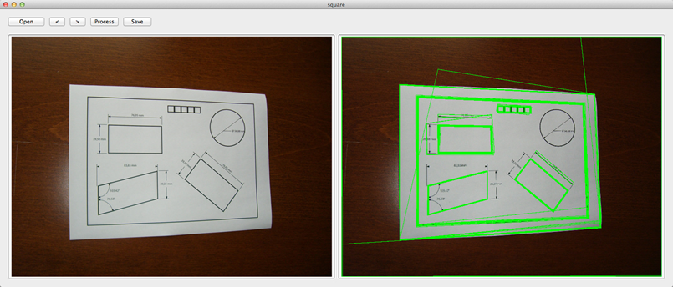
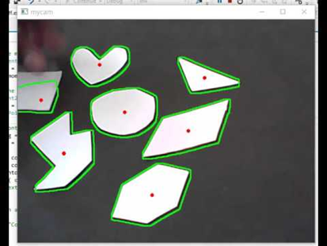
Contour Detection - Things to explore
Perimeter
Area
Moments (to find centre)
Approximation using polygons

Slide 52
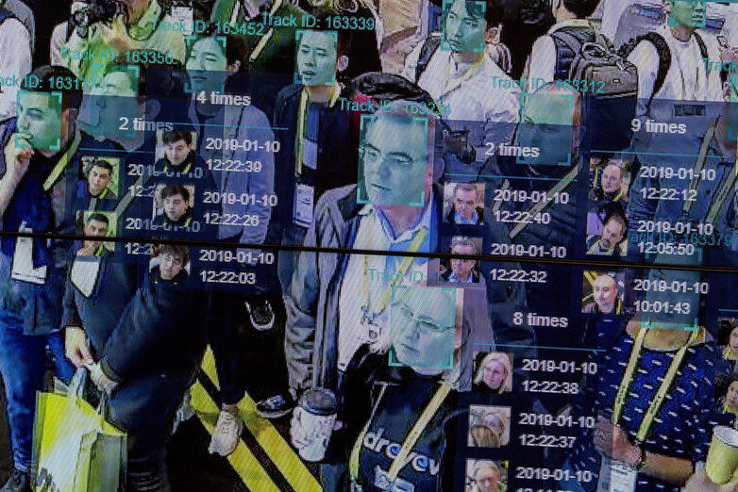
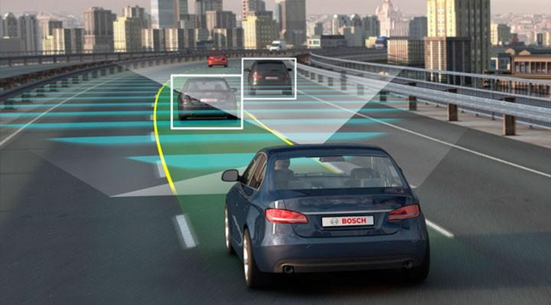
Applications of Image Processing/Computer Vision

Slide 53
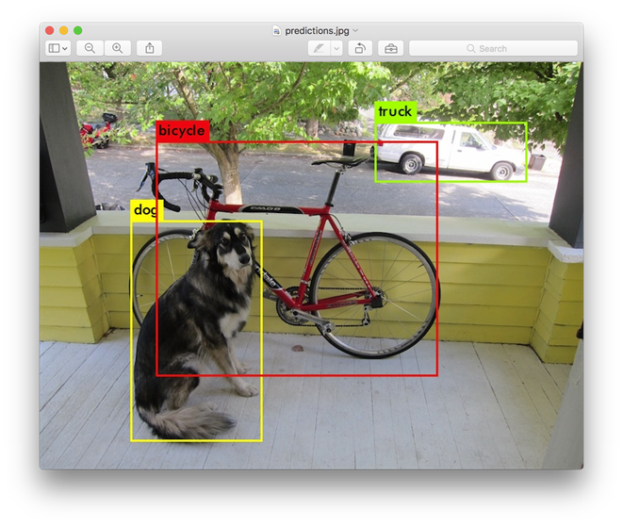

Machine Learning and other advances
https://pjreddie.com/darknet/yolo/
https://github.com/puzzledqs/BBox-Label-Tool
https://github.com/pytorch/vision/

Slide 54
Cool things to try out

Slide 55
Thank You !

